Slide 1
CYBER SECURITY
IV B.TECH II SEM

Slide 2
Syllabus
UNIT 1: Cyber crime: Mobile and Wireless devices-Trend in mobility-authentication service security-Attacks on mobile phones-mobile phone security Implications for organizations- Organizational measurement for Handling mobile-Security policies and measures in mobile computing era. Cases.

Slide 3
Learning Objectives
Understand the security challenges presented by mobile devices and information systems access in the cybercrime world.
Understand challenges faced by the mobile workforce and implication under the cybercrime era
Mitigation strategy – credit card users.
Security issues due to use of media players
Organizational security implications with electronic gadgets
Organizational measures for protecting information systems from threats in mobile computing area.
Smishing, vishing attacks in mobile world.
Security issues arising due to use of removable media- pen drives

Slide 4
Cyber Security Definition
Cyber security refers to the body of technologies, processes, and practices designed to protect networks, devices, programs, and data from attack, damage, or unauthorized access.
or
Availability, integrity and secrecy of information systems and networks in the face of attacks, accidents and failures with the goal of protecting operations and assets.
or
Cyber or Computer Security is the protection of computing systems and the data that these systems store or access.
Why do I need to know about cyber security:
It is estimated that 10% of security safeguards are technical in nature. Firewalls and Intrusion Detection devices are a few devices that can help prevent approximately 10% of security threats.
The additional 90% of safeguards rely on each of us. By understanding and adhering to these safeguards, we can reduce or eliminate most cyber security threats.
Example: Locking your car doors is the 10%. Making sure nothing of value is left on the seat, windows are rolled up and parking in a safe area account for the remaining 90%.

Slide 5
Cyber security terminology
Cyber space: a place where you chat, explore, research and play through computer networks.
Cyber squatting: the act of occupying an abandoned/unoccupied space without any permission.
Cyber crime: A crime conducted in which either a computer was directly and significantly instrumental.
Cyber terrorism: any person, group or organization who, with terrorist intent, utilizes accesses or aids in accessing a computer, networks or electronic system by any available means, and thereby knowingly engages in a terrorist act.
Types of cyber criminals
Type -1: hungry for recognition
Type-2: not interested in recognition
Type-3: the insiders

Slide 6
Cybercrimes classification
Email-spoofing
Spamming
Cyberdefamation
Internet time theft
Salami attack
Data diddling
Forgery
Web Jacking
Newsgroup spam
Hacking
Online frauds
Software piracy
Computer sabotage
E-mail bombing
Password sniffing
Credit card frauds

Slide 7
PROLIFERATION OF MOBILE AND WIRELESS DEVICES
Mobile computing is taking a computer and all necessary files and software out into the field.
Types of mobile computers
Portable computer
Tablet PC
Internet tablet
PDA
Ultramobile PC
Smartphone
Carputer
Fly Fusion Pentop Computer

Slide 8
You see them everywhere: people hunched over their smartphones or tablets in cafes, airports, supermarkets and even at bus stops, seemingly oblivious to anything or anyone around them.
They play games, download email, go shopping or check their bank balances on the go.
They might even access corporate networks and pull up a document or two on their mobile gadgets.

Slide 9
Security?
But as wireless devices become increasingly ingrained into our daily lives, they open the door to heightened security risks.
Not only do such devices become points of access for cybercriminals, but they also may be more easily breached than personal computers since many consumers do not secure their smartphones or tablets with antivirus software or take simple precautions such as enabling password protection.
According to a Harris Interactive survey commissioned by CTIA, a wireless trade group,
less than half of all wireless device owners use passwords or personal identification numbers (PINs) on their handsets
Among those who conduct online banking on mobile devices, only half encrypt the data or use some form of security software.
Moreover, less than one third of users have installed antivirus software on their mobile devices compared to 91% on their laptops.
This may explain why: 45% do not see cybersecurity on their mobile devices as a threat in the same way as they see it on their computers

Slide 10
Risk factor
The dangers, of course, are plenty.
Rogue mobile apps can record the information that users type into a device, such as bank account numbers and PINs
They can read data stored on a handset, such as emails, text messages, attachments, credit card numbers, and log-ins and passwords to corporate networks.
A phone can even secretly record conversations within earshot.
Data that leaves a mobile device wirelessly to connect to a Wi-Fi network could be hijacked in midair in “man in the middle” attacks.
Consumers may not be as concerned about securing a wireless device because they do not view it as a small computer. “They think, ‘Oh, it’s just my phone.
he risks are transferred to the workplace as more people bring their devices to the office for both personal and professional use, a phenomenon known as BYOD or “Bring Your Own Device.”

Slide 11
TRENDS IN MOBILE SECURITY
Types of mobility
User mobility
Device mobility
Session mobility
Services mobility
Many surveys on mobility indicates that “handheld devices may look harmless but they can cause serious cybersecurity issues to the organizations.
3G networks are not entirely built with IP data security.

Slide 12
Popular types of attacks against 3G mobile networks:
Malware, viruses and worms
Skull Trojans- targets series 60 phones with Symbian OS
Cabir worm-infects phones running Symbian OS
Mosquito Trojans- targets series 60 phones and is a cracked version of mosquitos game
Brador Trojans-it affects windows CE OS by creating svchost.exe file in startup folder
Lasco Trojans-targes PDA and mobile phones with Symbian OS and it is based o cabir code.
Denial-of-service
Overbilling attack
Spoofed policy development process
Signaling-level attacks

Slide 13
Skull trojan
A trojan horse piece of code that targets mainly Symbian OS. Once downloaded, the virus replaces all phone desktop icons with images of a skull. It also renders all phone applications useless. This malware also tends to mass text messages containing malicious links to all contacts accessible through the device in order to spread the damage. This mass texting can also give rise to high expenses.

Slide 14
Cabir worm
This malware infects mobile phones running on Symbian OS and was first identified in June 2004. When a phone is infected, the message 'Caribe' is displayed on the phone's screen and is displayed every time the phone is turned on. The worm then attempts to spread to other phones in the area using wireless Bluetooth signals, although the recipient has to confirm this manually.

Slide 15
Mosquito worm
In June 2004, it was discovered that a company called Ojam had engineered an anti-piracy Trojan virus in older versions of its mobile phone game, Mosquito.
This virus sent SMS text messages to the company without the user's knowledge.
Although this malware was removed from the game's more recent versions, it still exists in older, unlicensed versions, and these may still be distributed on file-sharing networks and free software download web sites.

Slide 16
list of mobile vulnerabilities
Mobile devices often do not have passwords enabled.
Two-factor authentication is not always used when conducting sensitive transactions on mobile devices.
Wireless transmissions are not always encrypted
Mobile devices may contain malware.
Mobile devices often do not use security software.
Operating systems may be out-of-date.
Software on mobile devices may be out-of-date
Mobile devices often do not limit Internet connections.
Mobile devices may have unauthorized modifications.
an unsecured WiFi network could let an attacker access personal information from a device, putting users at risk for data and identity theft.

Slide 17
CREDIT CARD FRAUDS
Mobile credit card transactions are very common
Types and techniques of credit card frauds:
Traditional techniques
Modern techniques
Traditional techniques- it is a paper based fraud or application based fraud
Application fraud can be divided into two:
ID theft: Where an individual pretended to be someone else
Financial Fraud: Where an individual gives false information about his or her financial status to acquire credit.

Slide 18
Credit Card Fraud
Modern technique- enable criminals to produce fake and doctored cards. They use skimming or site cloning to commit fraud.
Triangulation: The criminals gets the details of credit card with fake web sites and use them.
Credit Card generators: Computer emulator software that creates a valid credit card numbers and expiry dates.

Slide 19
SECURITY CHALLENGES POSED BY MOBILE DEVICES
Two challenges
One at the device level: microchallenges
Another at the organization level: macrochallenges

Slide 20
Well know challenges in mobile security:
Managing the registry setting and configuration
Authentication Service Security
Cryptography Security
Lightweight Directory Access protocol(LADP) Security
Remote Access Server(RAS) security
Media Player Control Security
Network Application Program Interface (API) security

Slide 21
1.Registry settings for mobile devices: example
Microsoft Active Sync : synchronize PCs and MS Outlook
Gateway between Windows-Powered PC and Windows mobile-Powered device
Enables transfer of Outlook information, MS Office documents, pictures, music, videos and applications
Active sync can synchronize directly with MS Exchange Sever so that the user can keep their E-Mails, calendar, notes and contacts updated wirelessly.

Slide 22
Managing the registry setting and configuration:
If you use an Active Directory® environment to administer the computers in your network, Group Policy provides a comprehensive set of policy settings to manage Windows® Internet Explorer® 8 after you have deployed it to your users' computers.
You can use the Administrative Template policy settings to establish and lock registry-based policies for hundreds of Internet Explorer 8 options, including security options.
1700 settings in a standard group policy

Slide 23
Managing the registry setting and configuration:
Even if the user go through every control panel setting and group policy option- no desired baseline security
So make additional registry changes that are not exposed to any interface: avoid “registry hacks”

Slide 24
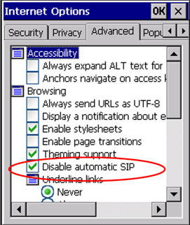
Example
When using Pick-IT ASP in Internet Explorer, the SIP (software input panel, or virtual keyboard) will pop up when a textbox is activated. We cannot control this panel through Pick-IT. The method disables this SIP, depending on your mobile device model and operating system.

Slide 25
2. Authentication Service Security
Two components of security in mobile computing:
Security of devices
Security in Networks
Involves mutual authentication between the device and the base station/ servers.
Ensures that only authenticated devices can be connected to the network
Hence, no malicious code can impersonate the service provider to trick the device.

Slide 26
Eminent kinds of attacks on mobile devices:
Push attacks
Pull attacks
Crash attack

Slide 27
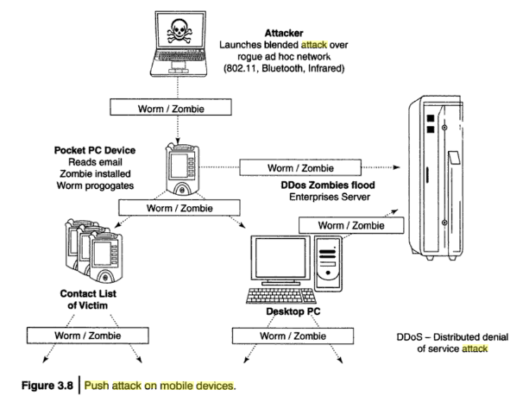
Push Attack

Slide 28
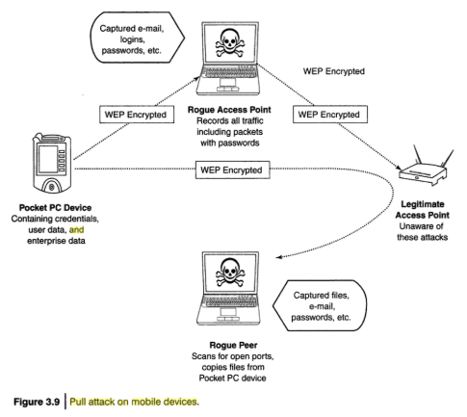
Pull attack

Slide 29
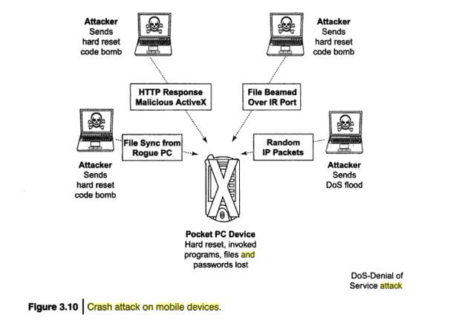
Crash attack

Slide 30
3.Cryptographic Security for Mobile Devices:
Cryptographically Generated Address (CGA)
CGA is IPv6: generated by hashing owner’s public-key address
The address the owner uses is the corresponding private key to assert address ownership and
To sign messages sent from the address without a Public-Key Infrastructure(PKI)
CGA-based Authentication can be used to protect IP-Layer signaling protocols
Also used in key –exchange and create an IPSec security association for encryption and data authentication

Slide 31
Example: Palm OS5
Cryptographic Provider Manage(CPM) in Palm OS5 is a system-wide suite of cryptographic services for securing data and resources on a Palm- powered device

Slide 32
4. LDAP security for hand held mobile computing devices
LDAP is a software protocol for enabling anyone to locate individuals, organizations and other resources like files and devices on the network
LDAP is light weight version of Directory Access Protocol(DAP) since it does not include security features in its initial version.
It originated at the University of Michigan
Endorsed by atleast 40 companies
Centralized directories such as LDAP make revoking permissions quick and easy.

Slide 33
LDAP directory Structure: simple tree structure
Root directory
Countries
Organizations
Organizational units
individuals

Slide 34
5. RAS security for mobile devices
RAS is important for protecting business sensitive data that ay reside on the employee’s mobile devices.
Vulnerable to unauthorized access : resulting in providing a route into the systems with which they connect
By impersonating or masquerading to these systems, a cracker is able to steal data or compromise corporate systems in other ways.
Another threat is by port scanning: DNS server- locate IP address- scan the port on this IP address that are unprotected.
Precautions: a personal firewall

Slide 35
RAS system security for Mobile device clients
The security of the RAS server
The security of the RAS client
The secure data transmission

Slide 36
6. Media Player Control Security
Potential security attacks on mobile devices through the “music gateways”
Windows media player: MS warned about security loop holes
Corrupt files posing as normal music and video files
May open a website from where the Javascript can be operated.
Allow attacker to download and use the code on user’s machine
Create buffer overrun errors.

Slide 37
7. Networking API security for mobile computing applications
With advent of E-commerce and M-commerce payments are becoming common phenomenon with the payment gateways accessed remotely and wirelessly.
Development of various API’s to enable software and hardware developers to write single applications to target multiple security platforms .

Slide 38
ATTACKS ON MOBILE/ CELL PHONES
Mobile Phone Theft
Mobile Viruses
Mishing
Vishing
Smishing
Hacking bluetooth

Slide 39
Mobile phone theft
With mobiles or cell phones becoming fancier, more popular, and more expensive, they are increasingly liable to theft.
Many insurance companies stopped offering Mobile Theft insurance due to large number of false claims.
When anyone losses his/her mobile phone, more than anything “Contact List” and “Personal Identifiable Information”, that really matter are lost.

Slide 40
Mobile phone theft
After PC, the attackers new playground is cell phones.
The following factors contribute for outbreaks on mobile devices:
1. Enough target terminals: first mobile virus in 2004 :- Mosquito – this virus sent SMS text messages to the organization(Ojam) without the user knowledge.
2. Enough functionality: Mobile devices are equipped with office functionality, critical data and applications are protected insufficiently or not at all.
expanded functionality also increases the probability of malware.

Slide 41
3. Enough connectivity: Smartphones offer multiple communication options like SMS, MMS, Synchronization, Bluetooth, infrared(IR) and WLAN connections.
The increased amount of freedom also offers more choices of virus writers.

Slide 42
How to Protect a Mobile Phone from Being Stolen
Keep details. Make a record of all your phone information and keep this in a safe place. Include the following elements in the information: Your phone number
The make and model
Color and appearance details
The pin or security lock code
The IMEI number (on GSM phones)
International Mobile Equipment Identity

Slide 43
Contd..
Add a security mark. Use an permanent marker or ultra violet pen to print your post code and house number onto both your mobile handset and battery. This makes it easily identifiable as your property if lost or stolen. It would also be good if you write your alternate contact number or email id on your phone.
This would help the finder of your handset to contact you if he or she intents to return it. The ultra-violet pen marking will wear off every couple of months, so reapply it when you feel necessary.

Slide 44
Use the security lock code, or PIN feature, to lock your phone. This will make it less valuable to a thief and deny them access to personal numbers stored on your SIM card.

Slide 45
Register your phone with your network operator. If your phone is stolen, report the loss to them immediately. Using your IMEI number, they may be able to block your hand set and account details.
Some wireless carriers are willing to do this, and some aren't. If done, this will prevent anyone from using the phone across any network, even if the SIM card is changed. Keep in mind that once the phone is disabled, it may not be able to be used again, even if you get it back.
Keep records of this call--the date, time, name of the person you spoke to, what they said, and their extension. Ask for confirmation in writing that your phone has been disabled.^{[2]} This is important in case the thief makes fraudulent charges on your account.

Slide 46
Have your phone number disabled. In addition to reporting your phone lost or stolen, you should also disable your phone number (not account) so that no further charges can be applied. This is in case the thief figures out how to access your account through another hand set, or in case the carrier is unwilling to block the handset. Remember that, as mentioned earlier, many thieves stand to benefit from using your service rather than selling your phone, especially between the moment they steal it and the moment you realize your phone is missing.^{[3]} As in the previous step, keep detailed records of when you requested your account to be disabled.

Slide 47
Request an immediate, formal investigation from your carrier. Sometimes this can prevent (or at least delay) the carrier from launching a collections effort and tainting your credit, if things get ugly. ^{[4]}
File a police report immediately. Time is money, literally. A thief can add over US$10,000 to your cell phone bill in just hours by making international calls, and you might end up being asked to foot the bill. Some phone companies may require proof that the phone was actually stolen, versus it having been lost. A police report serves as evidence, which will make your wireless provider more cooperative, especially if insurance is involved.

Slide 48
Install anti phone theft software. There are suppliers that provide modern anti theft software for your phone. The software enables you to remotely contact your mobile and stay in control. For example, one of the recently published solutions for Symbian and Android is Theft Aware; others provide Windows Mobile or Blackberry support
Never let the phone get out of your sight. Unless you are sleeping of course, always have your eyes on the phone.

Slide 49
2. Mobile Viruses
A mobile virus is similar to a computer virus that targets mobile phones data or applications/software installed init.
In total 40 mobile virus families and more than 300+ mobile viruses identified
First mobile virus : june 2004
Spread through dominant communication protocols
Bluetooth, MMS.
Bluetooth virus can easily spread within a distance of 10-30 mt.
MMS virus can send a copy of itself to all mobile users whose numbers are available in the infected mobile phone address book.

Slide 50
Mobile Phone Virus Hoax
Variants of this hoax have been circulating since 1999. The information in the email is completely untrue and has certainly not been "confirmed by both Motorola and Nokia".

Slide 51
Mobile Phone Virus Hoax Example
All mobile users pay attention!!!!!!!!! If you receive a phone call and your mobile phone displays(XALAN)on the screen don't answer the call, END THE CALL IMMEDIATELY,if you answer the call,your phone will be infected by a virus. This virus WILL ERASE all IMEI and IMSI information from both your phone and your SIM card, which will make your phone unable to connect with the telephone network. You will have to buy a new phone. This information has been confirmed by both Motorola and Nokia. There are over 3 Million mobile phones being infected by this virus in all around the world now. You can also check this news in the CNN web site. PLEASE FORWARD THIS PIECE OF INFORMATION TO ALL YOUR FRIENDS HAVING A MOBILE PHONE.

Slide 52
How to protect from mobile malware attacks
Following are some tips to protect mobile platform malware attacks.
Download or accept programs and content only from a trusted source
Turn off bluetooth or set it to non-discoverable when not in use
Receive IR ( Infra Red) beams only from trusted source
Install antivirus software for mobile devices.

Slide 53
3. Mishing
'Mishing' is a combination of the words mobile phone and phishing.
Mishing is very similar to phishing—the only difference is the technology.
Phishing(wikipedia) : It is the criminally fraudulent process of attempting to acquire sensitive information such as usernames , passwords and credit card details by masquerading as a trustworthy entity in an electronic communication.
Phishing involves the use of emails to trick you into providing your personal details, whereas mishing involves mobile phones.
If you use your mobile phone for purchasing goods and services and convenient banking, you could be more vulnerable to a mishing scam.

Slide 54
Variants of Mishing
Vishing : Mishing attacker makes call for phishing
Smishing: Mishing attacker sends SMS for phishing

Slide 55
Vishing
The term "vishing" is a socially engineered technique for stealing information or money from consumers using the telephone network.
The term comes from combining "voice" with "phishing," which are online scams that get people to give up personal information.
Vishing is very similar to phishing—the only difference is the technology.
Vishing involves voice or telephone services. If you use a Voice over Internet Protocol (VoIP) phone service, you are particularly vulnerable to a vishing scam.
Vishing is usually used to steal credit card numbers or other related data used in ID theft schemes from individuals.

Slide 56
Profitable uses of the information gained through a Vishing attack include:
ID theft
Purchasing luxury goods and services
Transferring money/ funds
Monitoring the victims bank accounts
Making applications for loans and credit cards

Slide 57
How Vishing works?
a vishing perpetrator (visher) may gain access to a group of private customer phone numbers.
The visher may then call the group(may use war dialer)
When a potential victim answers the phone, he or she hears an automated recording informing him that his bank account has been compromised.
He then calls the specified toll-free number to reset his security settings and hears another automated message requesting the user’s bank account number and/or other personal details via the phone keypad..

Slide 58
Some examples
1. Automated Message: Thank you for calling ( name of local bank). Your business is important to us. To help you reach the correct representative and answer your query fully, please press the appropriate number on your handset after listening voicemail, are as follow
Press 1 if you need to check your banking details and live balance .
Press 2 if you wish to transfer funds.
2. Regardless of what the victim enters, the automated system prompts him to authenticate himself. To proceed further, we require that you authenticate your ID before proceeding. Please type your bank account number. Etc.

Slide 59
How to protect from Vishing attack?
Be suspicious of all unknown callers
Don't trust caller ID: caller ID spoofing is easy
Ask questions: ask them to identify who they work for, and then check them out to see if they are legitimate.
Call them back: call them back using a number from your bill or your card. Never provide credit card information or other private information to anyone who calls you
Report incidents: to nearest cyberpolice cell.

Slide 60
Smishing
Short for SMS Phishing, smishing is a variant of phishing email scams that instead utilizes Short Message Service (SMS) systems to send bogus text messages.
Also written as SMiShing, SMS phishing made recent headlines when a vulnerability in the iPhone's SMS text messaging system was discovered that made smishing on the mobile device possible.

Slide 61
How smishing works?
Smishing scams frequently seek to direct the text message recipient to visit a website or call a phone number, at which point the person being scammed is enticed to provide sensitive information such as credit card details or passwords.
Smishing websites are also known to attempt to infect the person's computer with malware.

Slide 62
Example
Text message originating from either notice@jpecu or message@cccu :
ABC CU – has –deactivated – your Debit_card. To reactivate contact:210957XXXX
This is an automated message from ABC Bank.
Your ATM card has been suspended. To reactivate call urgent at 1 866 215 XXXX
Text message originating from sms.alert@visa.com :
sms.alert@visa.com/VISA. (Card Blocked) Alert. For more information please call 1-877-269-XXXX

Slide 63
How to protect from Smishing attacks?
Do not answer a text message that you have received asking for your Personal Information.
Avoid calling any phone numbers, as mentioned in the receiving message, to cancel a membership or confirming a transaction which you have not initiated but mentioned in the message.
Never click on a hot link received through messages.

Slide 64

Hacking bluetooth
Bluetooth hacking is a technique used to get information from another Bluetooth enabled device without any permissions from the host.
This event takes place due to security flaws in the Bluetooth technology.
It is also known as Bluesnarfing.
Bluetooth hacking is not limited to cell phones, but is also used to hack PDAs, Laptops and desktop computers.
Bluetooth hacking is illegal and can lead to serious consequences.

Slide 65
Following are threats a person can face when his/her mobile phone gets bluesnarfed:
The hacker can steal, delete contacts
Hacker can extract personal files/pictures etc
Your cell phone can be used for making calls and using internet at your expense
The hacker may call or text your contacts to annoy them
You mobile phone can be reset to default factory settings hence deleting your personal settings
Hacker can even access your calendar, clock, International Mobile Equipment Identity (IMEI) number. IMEI number can be used to clone your cell phone so that your messages are also routed to another number. Cloning is also considered illegal.

Slide 66
Common attacks
Bluejacking: It is sending message over bluetooth to bluetooth-enabled devices such as mobile phones. For example, sending a visiting card which contains a message in the name field. User sometimes may add it to contacts and a message is sent back automatically. This attack is harmless as users think phone may be malfunctioning.
Bluesnarfing: It is unauthorized access and attackes are allowed to access calender, contact list, SMS and Email, picture and videos.

Slide 67
Bluebugging: It allows attackers to remotely access users phone and use its features like listening to calls and in next level they may make calls, send SMS read and write phone book contacts.
Car wishper: It is a piece of software that allows attackers to send and receive audio files from a Bluetooth enabled car stereo. More serious damage can be done by attackers by disabling airbags or brakes through this kind of attack.

Slide 68
The best way to avoid being "Car Whispered" is to simply connect the in-car system to a Bluetooth phone, because only one such device can be connected at a time.

Slide 69
Common bluetooth attack tools
BlueScanner
Bluesnarfer
BlueDiving
BlueBugger
bluesniff

Slide 70
MOBILE DEVICES: SECURITY IMPLICATIONS FOR ORGANIZATIONS
Managing diversity and proliferation of Hand-Held devices
Unconventional/ stealth storage devices
Threat through lost and stolen devices
Protecting data on lost devices
Educating the laptop users

Slide 71
1. Managing diversity and proliferation of Hand-Held devices
Employees aren't just bringing their mobile devices to the workplace—they're living on them
As smartphones and tablets become constant companions, cyber attackers are using every avenue available to break into them.
With the right (inexpensive) equipment, hackers can gain access to a nearby mobile device in less than 30 seconds and either mirror the device and see everything on it, or install malware that will enable them to siphon data from it at their leisure.

Slide 72
Managing diversity and proliferation of Hand-Held devices
Analysts predict that by 2018, 25 percent of corporate data will completely bypass perimeter security and flow directly from mobile devices to the cloud.
Chief information security officers (CISOs) and other security executives are finding that the proliferation of mobile devices and cloud services are their biggest barriers to effective breach response.
In order to secure the corporate data passing through or residing on mobile devices, it is imperative to fully understand the issues they present.

Slide 73
Unconventional/ Stealth Storage devices
Secondary storage devices
CDs
USBs
Portable external hard disks
Portable storage devices can be easily lost or stolen.
Decrease in size and emerge in new shape and sizes – difficult to detect
Prime challenge for organizational security
Firewalls and antivirus software are no defense against the open USB ports
Remedy- block these ports, but Windows OS do not support
Disgruntled employee can use these to download confidential data or upload harmful virus

Slide 74
Devicelock software
DeviceLock provides network administrators the ability to set and enforce contextual policies for how, when, where to, and by whom data can or can’t be moved to or from company laptops or desktop PCs via devices like phones, digital cameras, USB sticks, CD/DVD-R, tablets, printers or MP3 players.
In addition, policies can be set and enforced for copy operations via the Windows Clipboard, as well as screenshot operations on the endpoint computer.

Slide 75
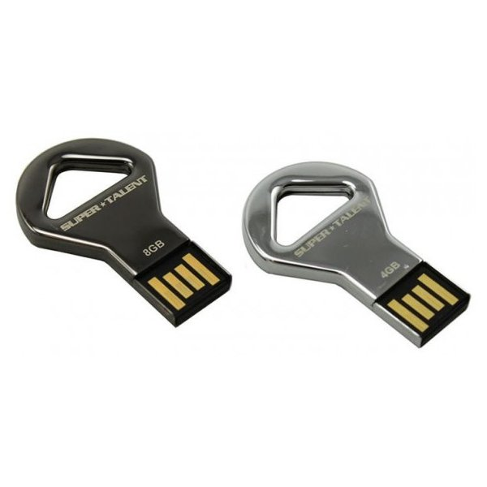


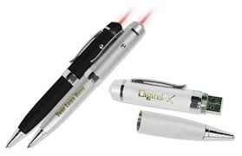
Stealth storage devices

Slide 76
Monitor which users or groups access USB ports, Wifi, Bluetooth, CD / DVD and other removable devices.
Control access to devices
Set devices in read-only mode.
Protect disks from accidental or intentional formatting.

Slide 77
3. Threats through lost and stolen devices
Often mobile hand-held devices are lost while people on move.
Lost mobile devices are becoming even a large security risk to corporations.
Most of the lost devices have a wireless access to a corporate network and have potentially very little security, making a weak link and a major headache for security maintenance.

Slide 78
4. Protecting data on lost devices
Encrypting sensitive data.
Encrypting entire file system.
Encrypting servers: third party solutions
Create a database action to delete the entire data on the user’s device

Slide 79
5. Educating the Laptop users
Often corporate laptop users could be putting company’s networks at risk by downloading non-work related software capable of spreading the viruses and spyware.
Many of the users use their laptops to download illegal music files and movies.
Only half of the companies have tools in place to manage the internet access on laptops.

Slide 80
Organizational Measures for Handling Mobile Devices-Related Security Issues
1. Encrypting Organizational Databases
2. Including Mobile Devices in Security Strategy

Slide 81
Encrypting Organizational Databases
Critical Data resides on databases in organizations. With latest technologies accessing data in databases through Hand-held devices is not impossible, so such databases should be encrypted.
Two algorithms are specified for strong encryption:
Rijndael: a block encryption algorithm, chosen as the new Advanced Encryption Standard for block ciphers by the National Institute of Standards and Technology(NIST).
MDSR(Multi-dimentional Space Rotation algorithm developed by casio.
Storing key is also important for encryption.

Slide 82
Including Mobile Devices in Security Strategy
Organizational IT department cannot specify using a mobile device may be unsecure.
A few things that enterprises can do are:
1. Implement strong asset management, virus checking, loss prevention and other controls for mobile devices that will prohibit unauthorized access and the entry of corrupted data.
2. Investigate alternatives that allow a secure access to the company information through a firewall, such a mobile VPNs.
3. Develop a system of more frequent and through security audits for mobile devices.

Slide 83
Contd..
4. Incorporate security awareness into your mobile training and support programs so that everyone understands how important an issue security is within a company’s overall IT Strategy.
5. Notify the appropriate law-enforcement agency and change passwords. User accounts are closely monitored for any unusual activity for a period of time.

Slide 84
Organizational Security Policies and Measures in Mobile Computing Era
Importance of Security policies relating to Mobile Computing Devices.
Operating Guidelines for Implementing Mobile Device Security.
Organization policies for the user of Mobile hand-held devices.

Slide 85
Importance of Security policies relating to Mobile Computing Devices.
Most of the users treat hand held devices as a wallet.
All the sensitive data is kept in the device and keep it on risk if it is stolen or lost.
Organizations cannot enforce a policy to avoid using cell phone by the workers.
Awareness among the users may be effective.
Survey released by Ponemon Institute, on behalf of cellcrypt, reveals that large and medium businesses are putting themselves at risk as a result of cell phone voice call interception.
EX: In a important organization conference senior managers and others uses cell phones.

Slide 86
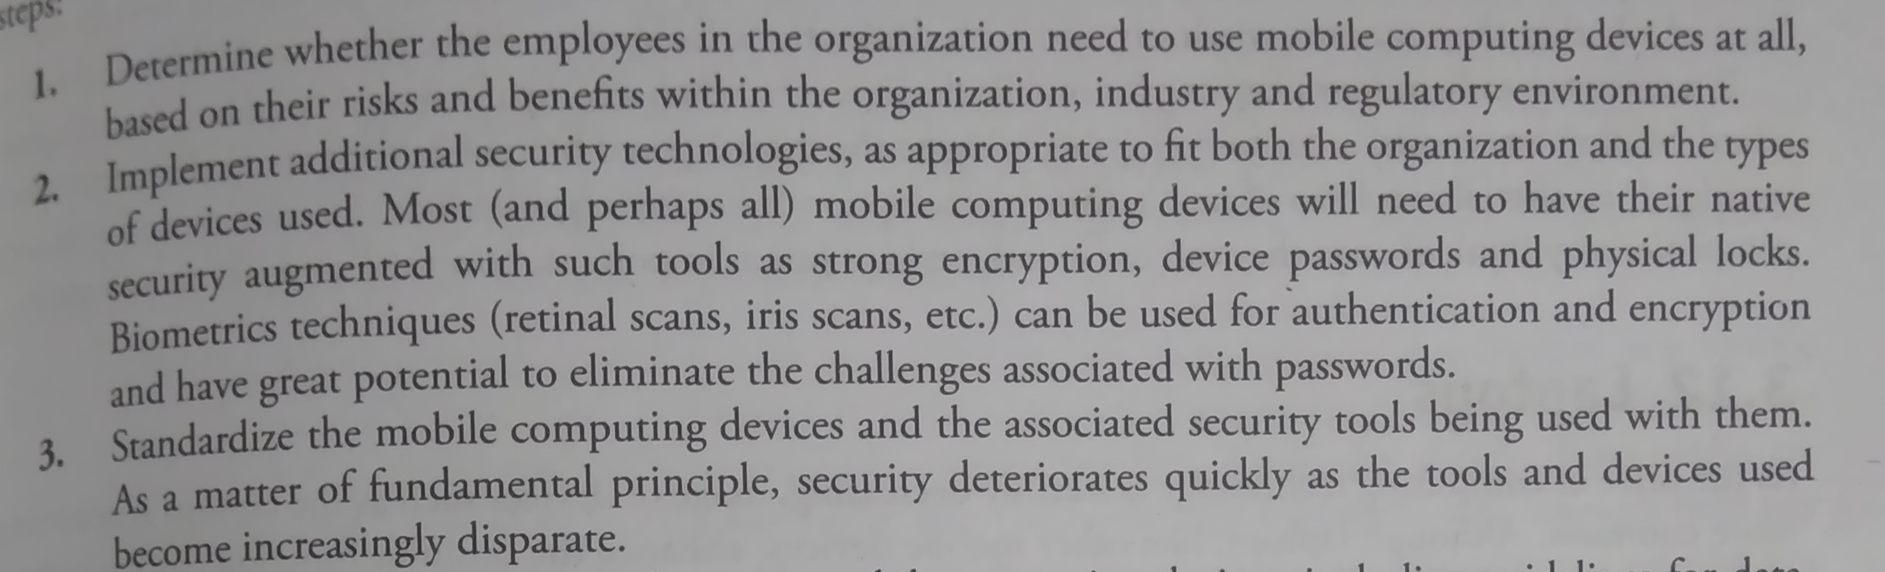
Operating Guidelines for Implementing Mobile Device Security.

Slide 87
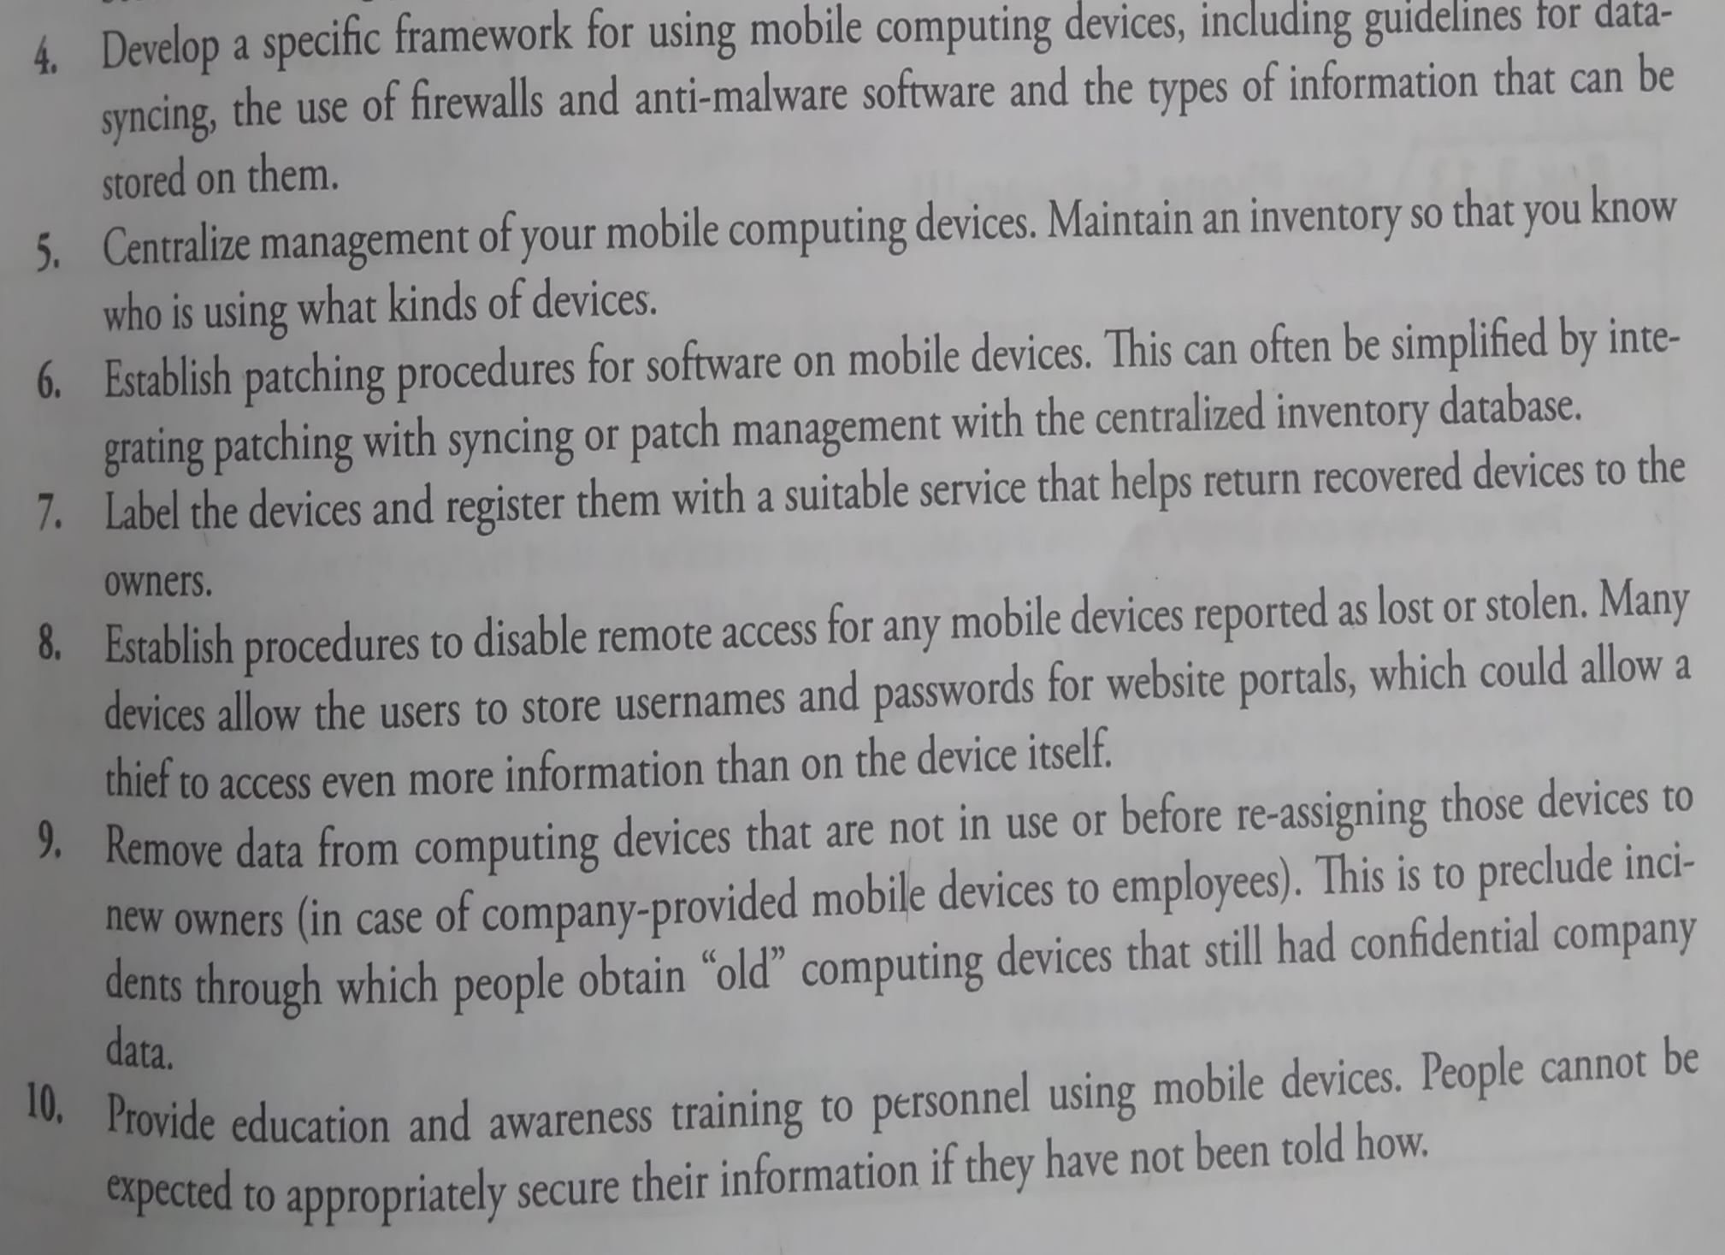

Slide 88
Organization policies for the user of Mobile hand-held devices.
The first step in securing mobile devices is creating company policies that address the unique issues these devices raise.
There are many ways to create a policy:
Create a distinct mobile computing policy
Include such devices under existing policy
Hybrid: existing and new policies

